Slide 1
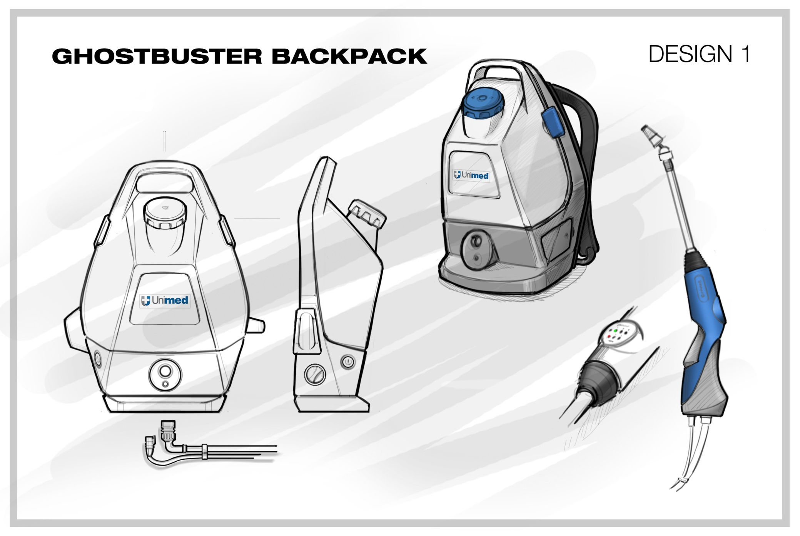
GhostBuster Backpack Design Sketch 1
Sep/03/2020
Remark from Designer:
This location will be further developed to hold the Nozzle Extender.
This is the storage for the Nozzle removal tool.
Aviton’s comments:
This is a traditional style but the Angles make it look different.
The base looks thin and the center of gravity looks to be effected by the angle away from the body..
1
2

Slide 2
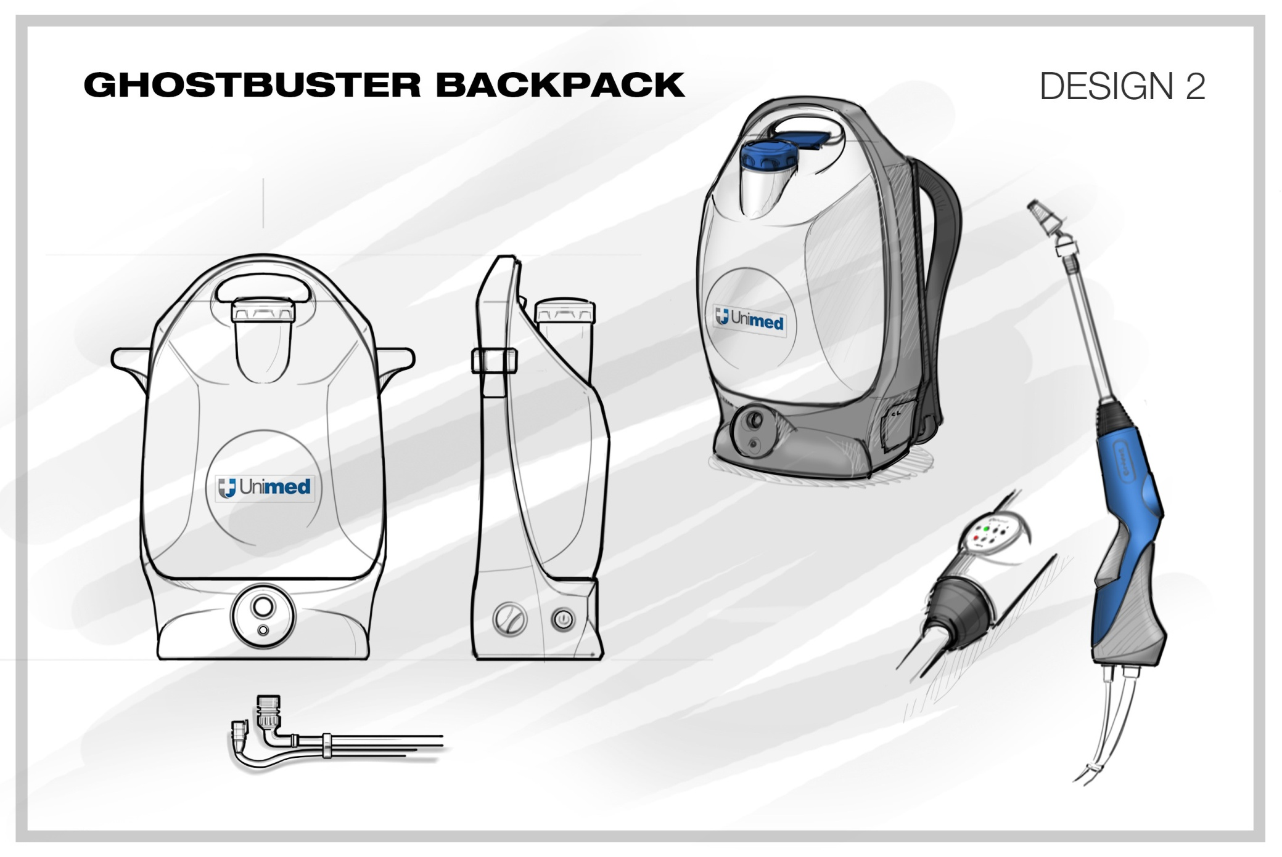
GhostBuster Backpack Design Sketch 2
Sep/03/2020
Remark from Designer:
This location will be further developed to hold the Nozzle Extender similar to the Design 1.
This is the storage for the Nozzle removal tool.
Aviton’s comments:
This is more traditional style of industrial equipment that similar to Victory Backpack.
1
2

Slide 3
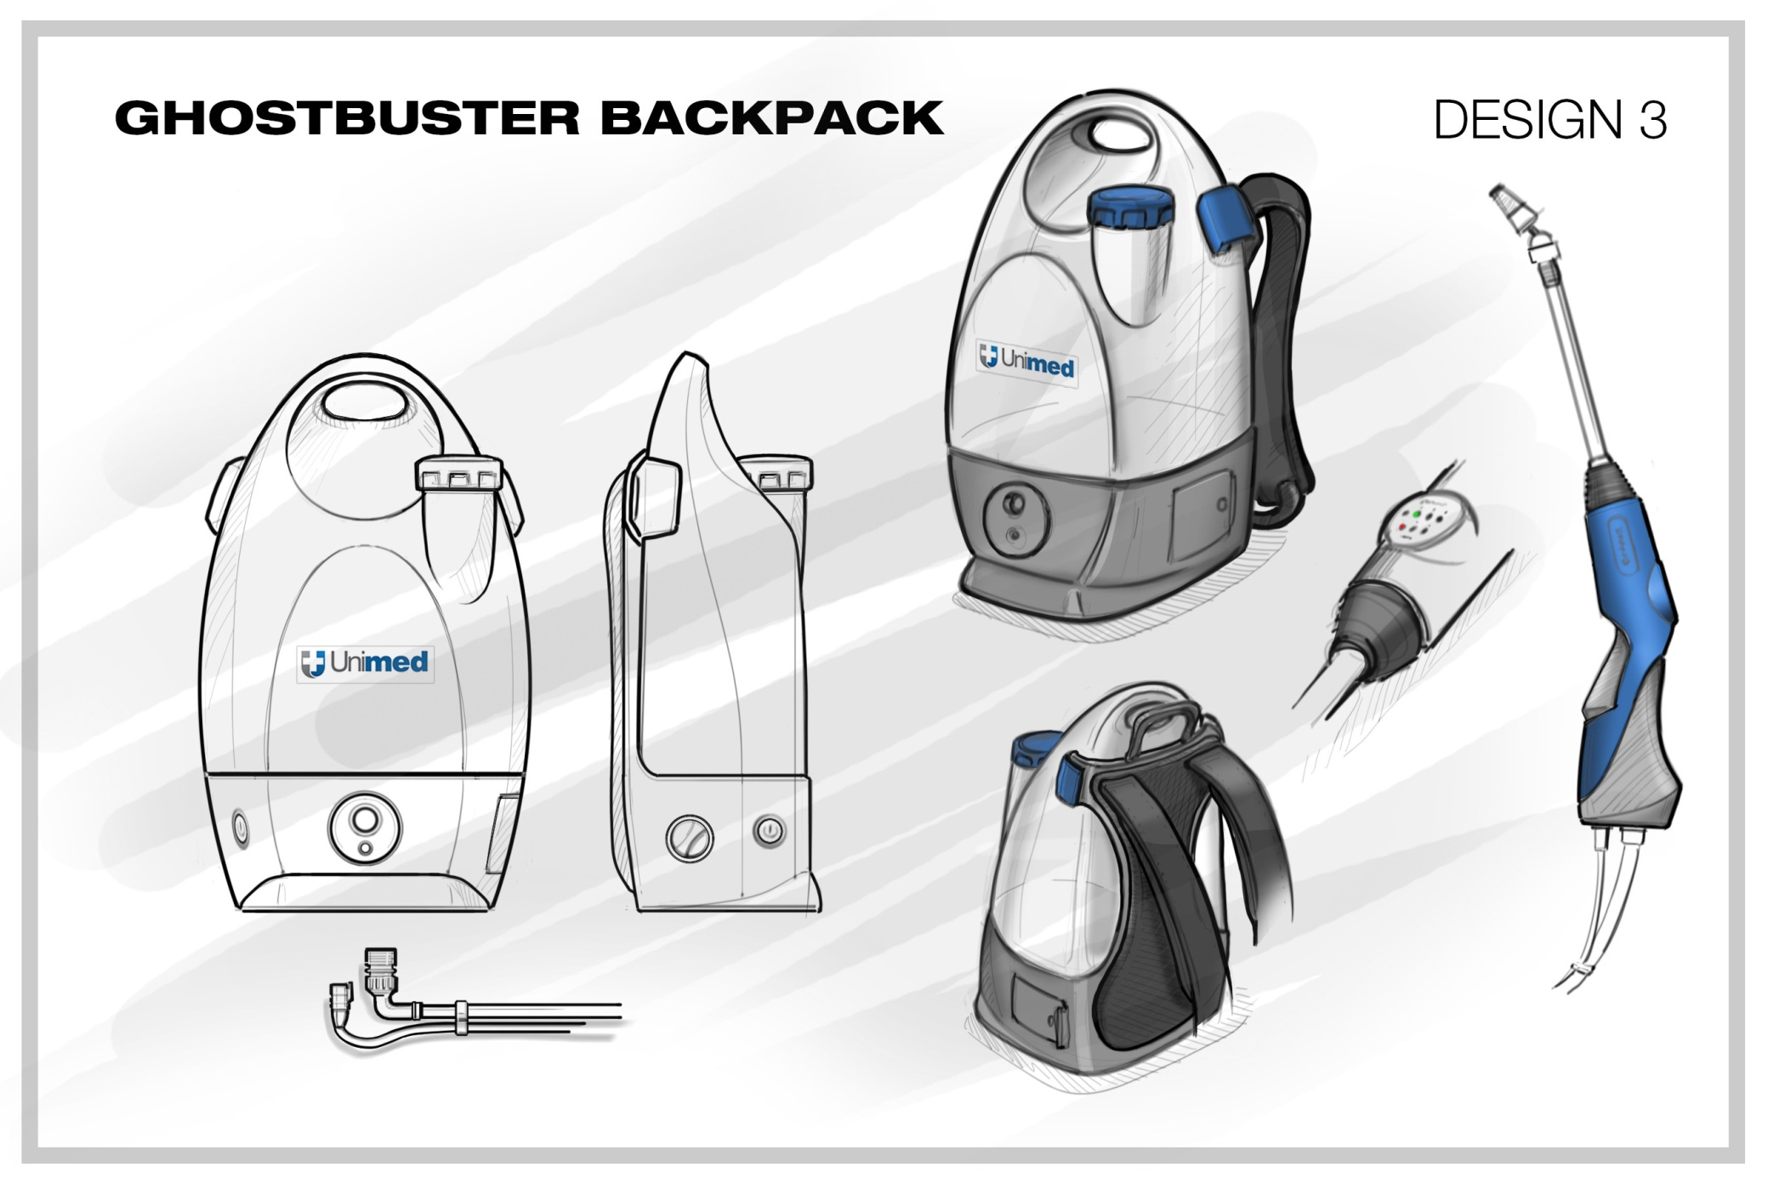
GhostBuster Backpack Design Sketch 3
Sep/03/2020
Remark from Designer:
The location for holding the Nozzle Extender to be confirmed.
This is the storage for the Nozzle removal tool.
Aviton’s comments:
The rounded is interesting and looks modern.
The handle on top of the backpack may not strong enough.
2

